Slide 1
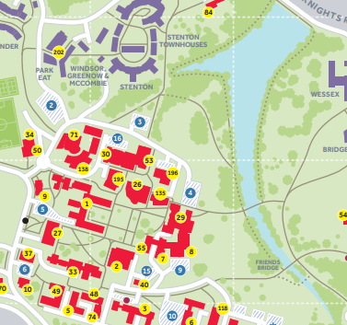
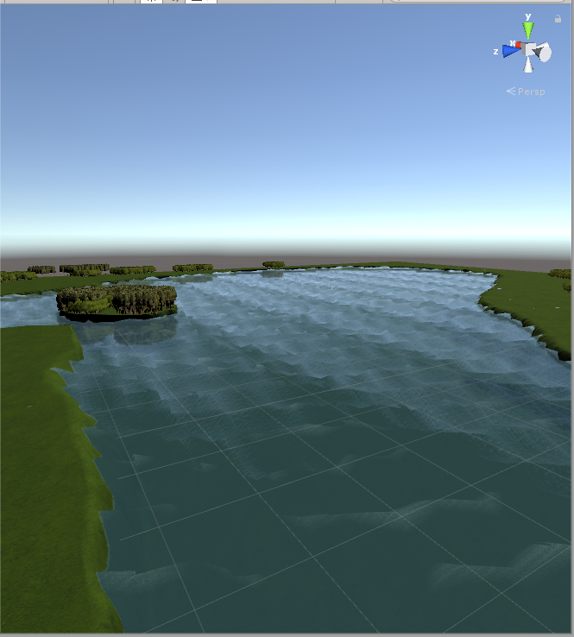
Virtual Tour of Whiteknights Campus for Android Virtual Reality
Introduction
The Virtual Tour of Whiteknights Campus is an Android application, which allows users to explore a part of Whiteknights campus using a teleportation based movement. The campus has been built using unity and runs on Nougat Android phones or higher.
The android application has been built using Unity and the models of the building was created using SketchUp and users are free to explore a part of WhiteKnights campus.
This project helps users who wish to come to University of Reading but may be unable to attend an open day, so they can download this app and then explore campus in Virtual Reality.
Features
The features of the Virtual Tour of campus is to provide users with the ability to explore campus in a virtual reality environment. Users can explore a part of WhiteKnights Campus by teleporting to an location where the user specifies, by holding down a button to show an indicator and then letting go once the user has chosen a location to be instantly teleported.
Another feature of the application is that the user can learn more about the backstory of each building by walking up towards it and pressing an button to hear an audio clip about the backstory of this building.
Implementation
The way the program is meant to be implemented is that University of Reading Open days member can bring a android phone with an virtual reality headset to open days (Such as in colleges or at schools) To promote the WhiteKnights campus and why they should study at university and ultimately study at University of Reading. Alternatively users can install the application on their android phones through the Google Play Store (Or on the University of Reading Website if it is not possible), to explore a virtual version of WhiteKnights campus with Guided tours if they are unable to come to any open days for any reason.
Objectives
The objectives of Virtual Tour of WhiteKnights Campus are:
Provide users with an comfortable experience of Virtual Reality (Allowing to explore campus at their own pace).
Learn about the history of each building in WhiteKnights Campus.
The App itself should be able to be installed on all phones running Android Nougat or higher and should provide smooth framerates and response no matter the hardware.
What parts of campus is covered?
Users can explore a part of WhiteKnights campus, they can explore the main areas of campus from the Palmer building up to the Urs building. They can also explore around the WhiteKnights Lake as well, if they wish to.
Explorable area of Whiteknights campus, not all of campus is covered however, but the main areas are explorable as well as the lake.
References
https://www.reading.ac.uk/web/files/whiteknights-campus-map-and-keys-2016.pdf - Map of WhiteKnights Campus
Degree programme
BSc Computer Science / BSc Information Technology
A screenshot of a Virtual Reality version of WhiteKnights Lake, built using Unity.

